Slide 1
Building Gateway Services
Graham Robinson
Yelcho Systems Consulting

Slide 2
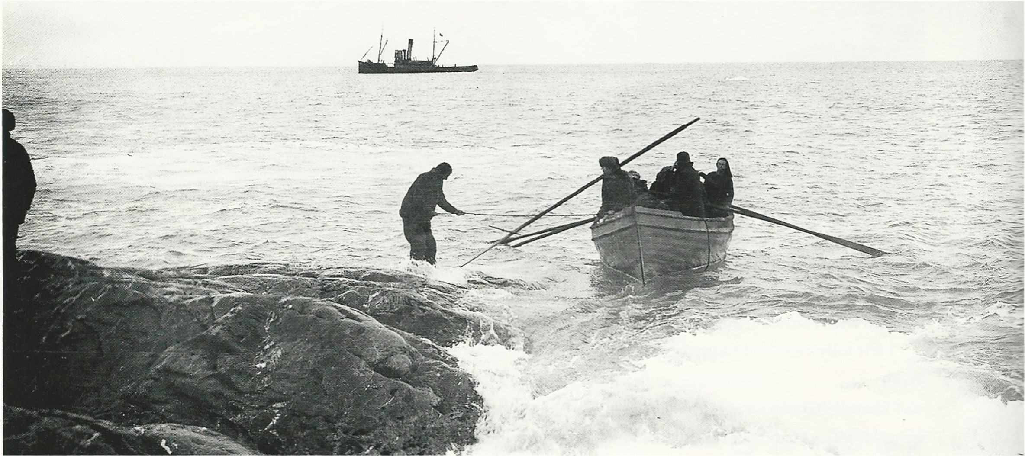




Introduction
+61 412 402 441
graham@yelcho.com.au
@grahamrobbo

Slide 3

Agenda
Some Warnings
Service Design
Code patterns for reusability

Slide 4
Agenda
Some Warnings
Service Design
Code patterns for reusability

Slide 5
Warning – This is not For Beginners

Slide 6
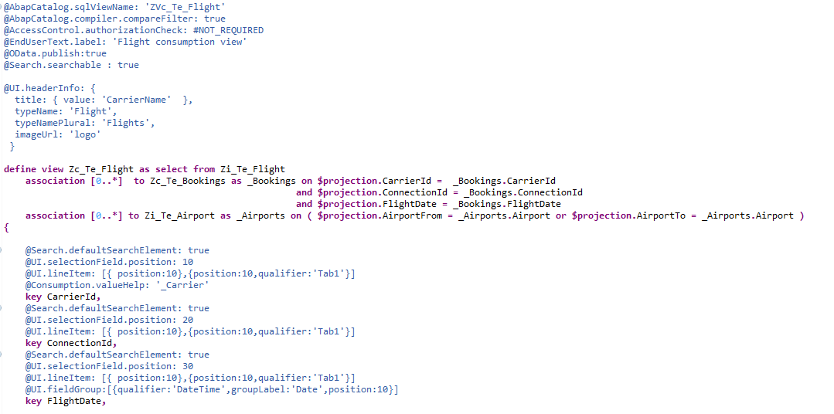
Warning - ABAP Core Data Services
Available
From 7.40 SP05

Slide 7
@OData.publish:true
We are not covering this

Slide 8
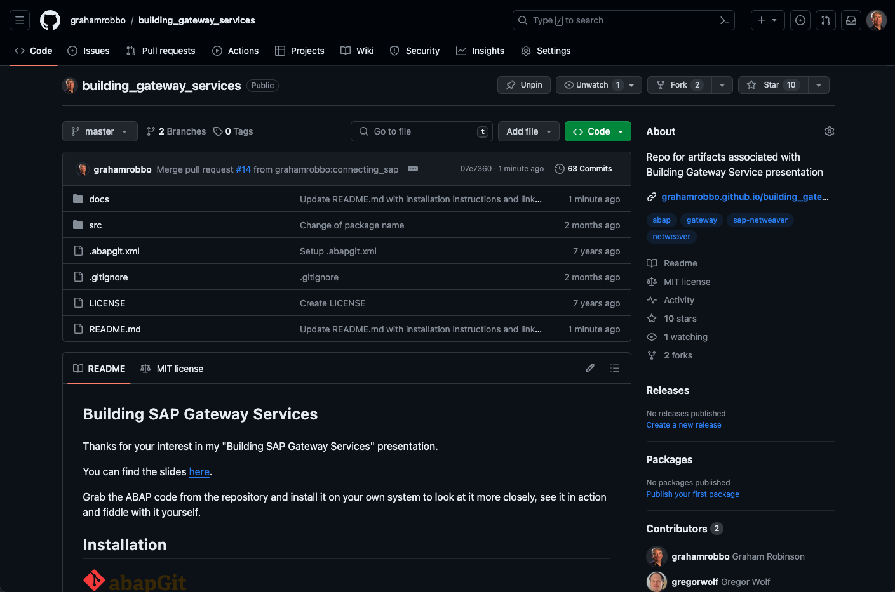

Warning - Homework
https://github.com/grahamrobbo/building_gateway_services

Slide 9
Warning – focus on consumption

Slide 10
Warning – I do not have all the answers
🤷🏻‍♂️

Slide 11
Agenda
Some Warnings
Service Design
Code patterns for reusability

Slide 12
Service Design Principles
Design for Consumers
Think oData i.e. Entities, Associations, etc.
Leave SAP domain knowledge at the door
REST API’s should be self-describing
Function Imports should be for special cases only

Slide 13
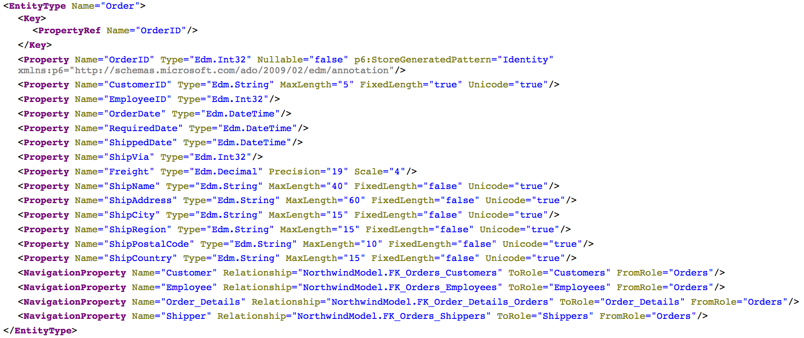
Consumer View of API
Source: http://services.odata.org/northwind/northwind.svc/$metadata

Slide 14
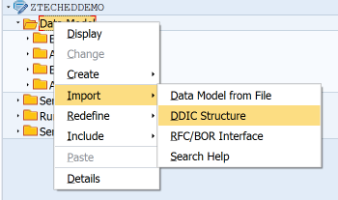
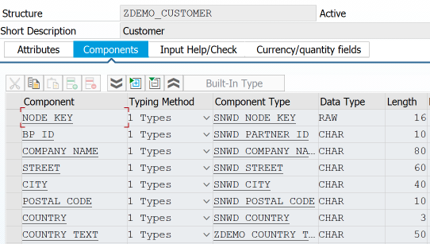
Bind Entity to DDIC Structure

Slide 15
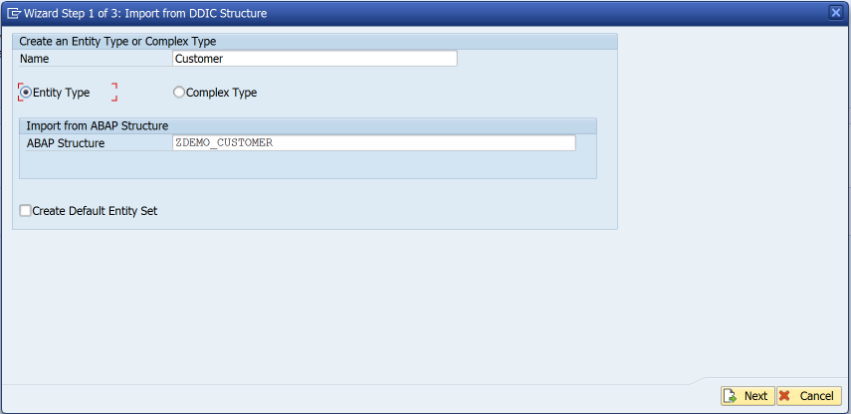
Bind Entity to DDIC Structure

Slide 16
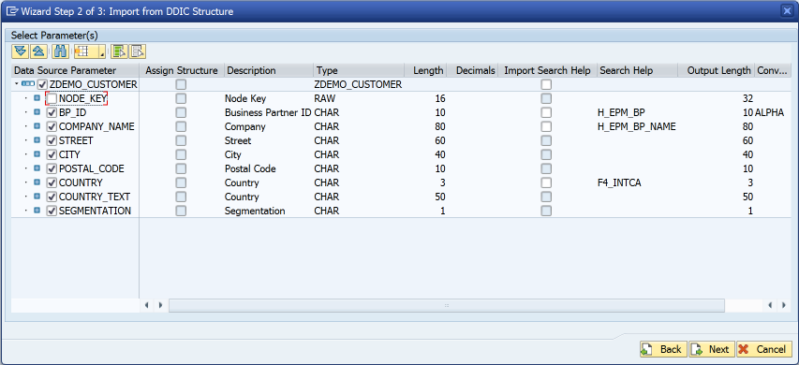
Bind Entity to DDIC Structure

Slide 17
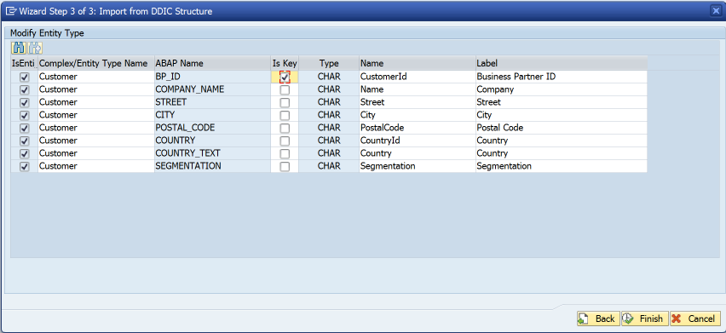
Bind Entity to DDIC Structure

Slide 18
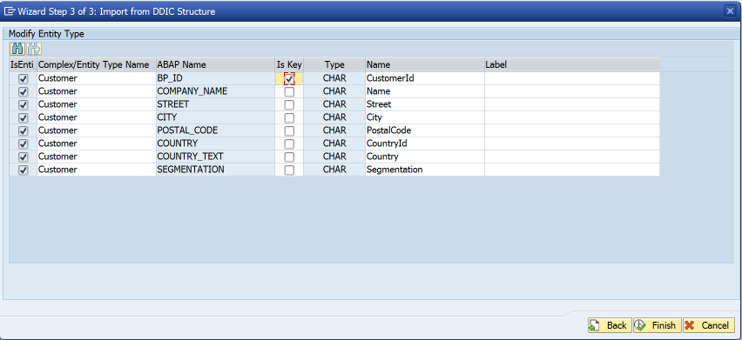
Bind Entity to DDIC Structure
Remove label suggestions
This means labels are determined at runtime rather than design-time

Slide 19
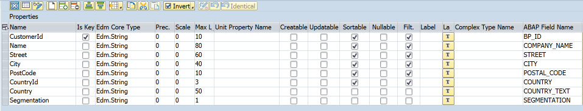
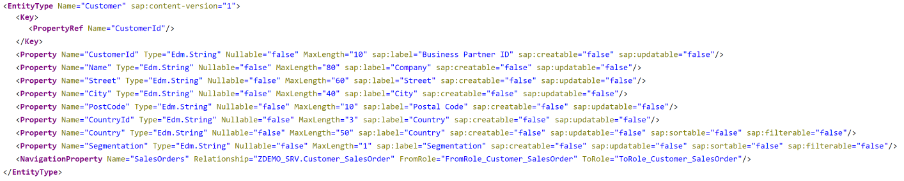
$metadata

Slide 20
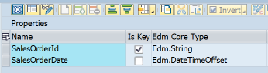
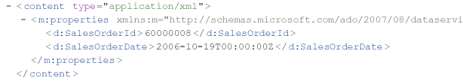
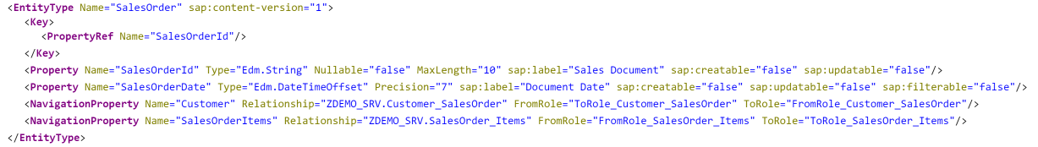
Dates & Times
Use Edm.DateTimeOffset for date/time/timestamp properties
Don’t be tempted to use Edm.String “for convenience”

Slide 21
Agenda
Some Warnings
Service Design
Code patterns for reusability

Slide 22
Code patterns for Reusability
1st rule of reusability
encapsulate all business logic in concrete classes

Slide 23
What a class is not
An ABAP class that only contains static methods is not really a class….. ... in all respects except object type it is analogous to a...
Function Group

Slide 24
Code patterns for Reusability
2nd rule of reusability
Refer to rule 1

Slide 25

Code patterns for reusability
I like the singleton design pattern in ABAP
Be aware that some people don’t
I don’t care – it works for me

Slide 26
Code patterns for reusability
I like getters (& sometimes setters) i.e. Accessors & Mutators
Be aware that some people don’t
I don’t care – it works for me

Slide 27
Code patterns for reusability
p.s. I also like …
named factory methods
statement chaining
zcl_customer=>get( cust_number )

Slide 28
Code patterns for reusability
p.s. I also like …
named factory methods
statement chaining
zcl_customer=>get( cust_number )->set_priority( 1 )

Slide 29

Code patterns for reusability
p.s. I also like …
named factory methods
statement chaining
zcl_customer=>get( cust_number )->set_priority( 1 )->set_important( abap_true ).

Slide 30
Code patterns for reusability
You can implement your business logic however you like… just remember the first & second rules of reusability

Slide 31
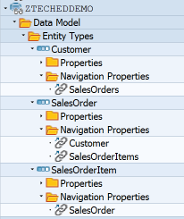
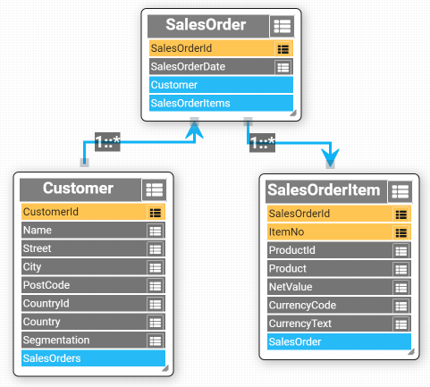
Sample Data Model
Based upon SAP Enterprise Procurement Model

Slide 32
Data Provider Class
DPC
DPC
DPC
zcl_demo_customer
zcl_demo_salesorder
zcl_demo_salesorderitem
Class

Slide 33
Multiple consumers
DPC
DPC
DPC
Class

Slide 34
Multiple consumers
DPC
DPC
DPC
Common Interface
Class

Slide 35
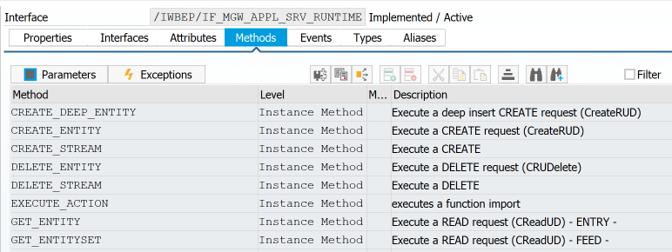
Replicate GW Method Interface

Slide 36
Avoid Using Deprecated Parameters

Slide 37
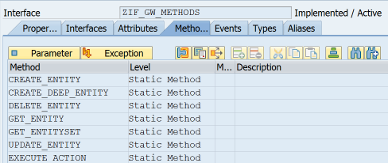
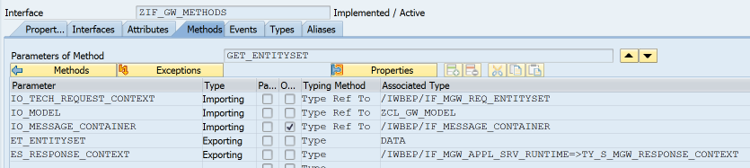
Common Interface
Model
Message Container
Untyped data object

Slide 38
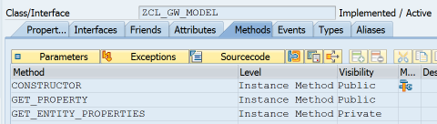
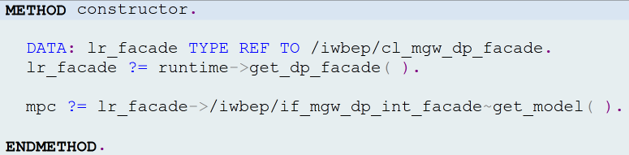
ZCL_GW_MODEL

Slide 39
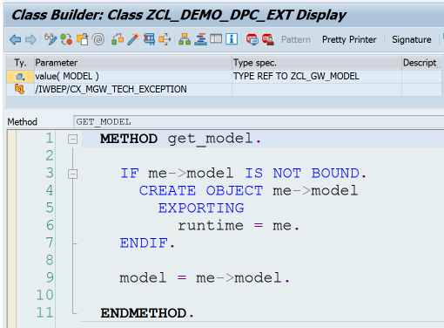
DPC->GET_MODEL

Slide 40
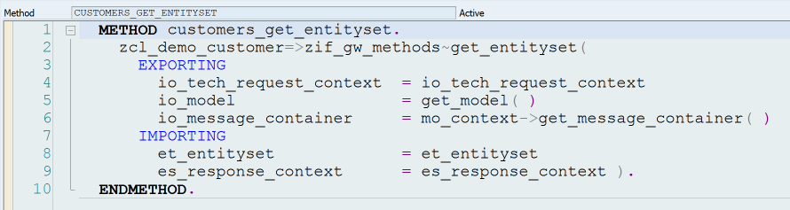
Call BO Class from DPC

Slide 41
oData Operations
 | Identify Primary Key(s) | Instantiate Class(es) | Call class methods | Fill Entity
Create
Read
Update
Delete

Slide 42
GET_ENTITY
Identify Primary Key(s)
Instantiate BO Class
Fill Entity

Slide 43
GET_ENTITY V1
DATA: lt_keys TYPE /iwbep/t_mgw_tech_pairs, ls_key LIKE LINE OF lt_keys, lv_bp_id TYPE snwd_partner_id, lo_customer TYPE REF TO zif_demo_customer, lr_entity TYPE REF TO data.
lt_keys = io_tech_request_context->get_keys( ). “ Identify Primary Key(s) READ TABLE lt_keys WITH KEY name = 'BP_ID' INTO ls_key. lv_bp_id = ls_key-value. lo_customer = zcl_demo_customer=>get_using_bp_id( lv_bp_id ). “ Instantiate BO Class GET REFERENCE OF er_entity INTO lr_entity. “ Fill entity lo_customer->zif_gw_methods~map_to_entity( EXPORTING entity = lr_entity entity_name = io_tech_request_context->get_entity_type_name( ) model = io_model ).

Slide 44
GET_ENTITY V2
lt_keys = io_tech_request_context->get_keys( ). READ TABLE lt_keys WITH KEY name = 'BP_ID' INTO ls_key. lv_bp_id = ls_key-value. lo_customer = zcl_demo_customer=>get_using_bp_id( lv_bp_id ). GET REFERENCE OF er_entity INTO lr_entity. lo_customer->zif_gw_methods~map_to_entity( EXPORTING entity = lr_entity entity_name = io_tech_request_context->get_entity_type_name( ) model = io_model ).

Slide 45
GET_ENTITY V2 – Table Expression
lt_keys = io_tech_request_context->get_keys( ). * READ TABLE lt_keys * WITH KEY name = 'BP_ID' * INTO ls_key. lv_bp_id = lt_keys[ name = ’BP_ID’ ]-value. lo_customer = zcl_demo_customer=>get_using_bp_id( lv_bp_id ). GET REFERENCE OF er_entity INTO lr_entity. lo_customer->zif_gw_methods~map_to_entity( EXPORTING entity = lr_entity entity_name = io_tech_request_context->get_entity_type_name( ) model = io_model ).

Slide 46
GET_ENTITY V2 – Table Expression
lt_keys = io_tech_request_context->get_keys( ). lv_bp_id = lt_keys[ name = ’BP_ID’ ]-value. lo_customer = zcl_demo_customer=>get_using_bp_id( lv_bp_id ). GET REFERENCE OF er_entity INTO lr_entity. lo_customer->zif_gw_methods~map_to_entity( EXPORTING entity = lr_entity entity_name = io_tech_request_context->get_entity_type_name( ) model = io_model ).

Slide 47
GET_ENTITY V2 – Conversion Operator
lt_keys = io_tech_request_context->get_keys( ). * lv_bp_id = lt_keys[ name = ’BP_ID’ ]-value. lo_customer = zcl_demo_customer=>get_using_bp_id(
CONV #( lt_keys[ name = ‘BP_ID’ ]-value ) ). GET REFERENCE OF er_entity INTO lr_entity. lo_customer->zif_gw_methods~map_to_entity( EXPORTING entity = lr_entity entity_name = io_tech_request_context->get_entity_type_name( ) model = io_model ).

Slide 48
GET_ENTITY V2 – Conversion Operator
lt_keys = io_tech_request_context->get_keys( ). lo_customer = zcl_demo_customer=>get_using_bp_id(
CONV #( lt_keys[ name = ‘BP_ID’ ]-value ) ). GET REFERENCE OF er_entity INTO lr_entity. lo_customer->zif_gw_methods~map_to_entity( EXPORTING entity = lr_entity entity_name = io_tech_request_context->get_entity_type_name( ) model = io_model ).

Slide 49
GET_ENTITY V2 – Reference Operator
lt_keys = io_tech_request_context->get_keys( ). lo_customer = zcl_demo_customer=>get_using_bp_id(
CONV #( lt_keys[ name = ‘BP_ID’ ]-value ) ). * GET REFERENCE OF er_entity INTO lr_entity. lo_customer->zif_gw_methods~map_to_entity( EXPORTING entity = REF #( er_entity ) entity_name = io_tech_request_context->get_entity_type_name( ) model = io_model ).

Slide 50
GET_ENTITY V2 – Method Chaining
DATA(keys) = io_tech_request_context->get_keys( ). zcl_demo_customer=>get_using_bp_id(
CONV #( keys[ name = ‘BP_ID’ ]-value )
)->zif_gw_methods~map_to_entity( EXPORTING entity = REF #( er_entity ) entity_name = io_tech_request_context->get_entity_type_name( ) model = io_model ).

Slide 51
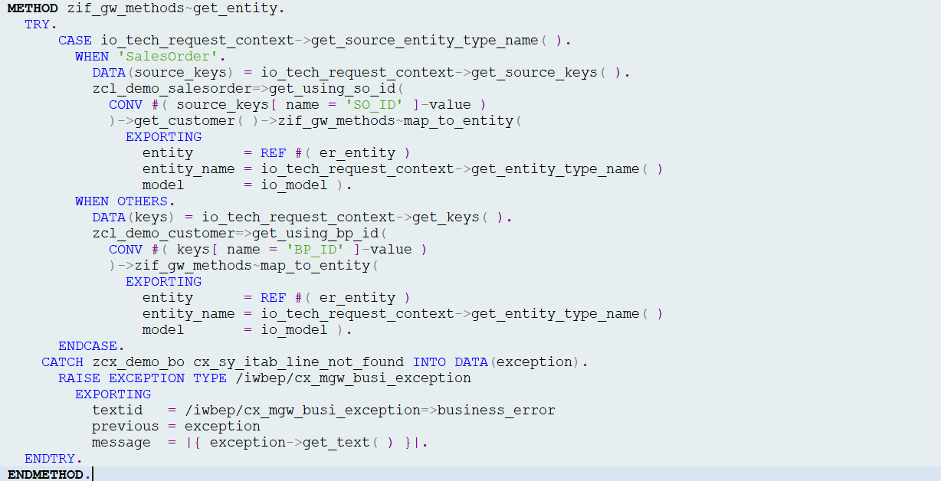
zif_gw_methods~get_entity

Slide 52
zif_gw_methods~get_entity
Use salesorder key to get customer

Slide 53
zif_gw_methods~get_entity
Exception handling

Slide 54
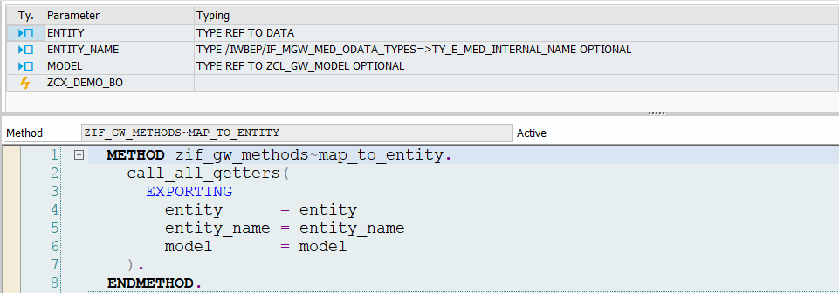

map_to_entity

Slide 55
map_to_entity

Slide 56
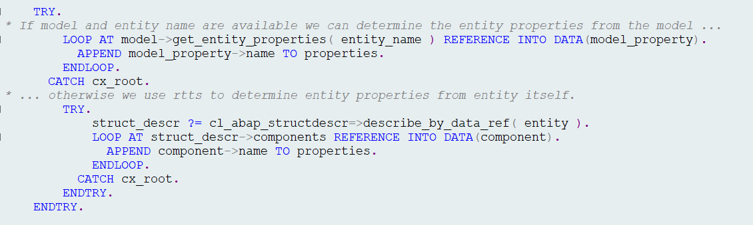
call_all_getters

Slide 57
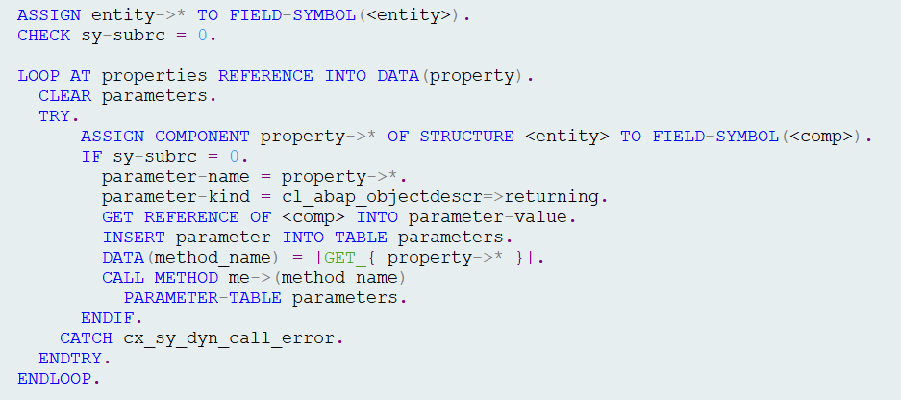
call_all_getters
For each entity component we attempt
to call matching getter functional method
e.g <entity>-city = me->get_city( ).

Slide 58
GET_ENTITY
Identify Primary Key(s)
Instantiate BO Class
Fill Entity

Slide 59
GET_ENTITYSET
Identify Primary Key(s)
For Each {
Not so simple
Instantiate BO Class
Fill Entity
}

Slide 60
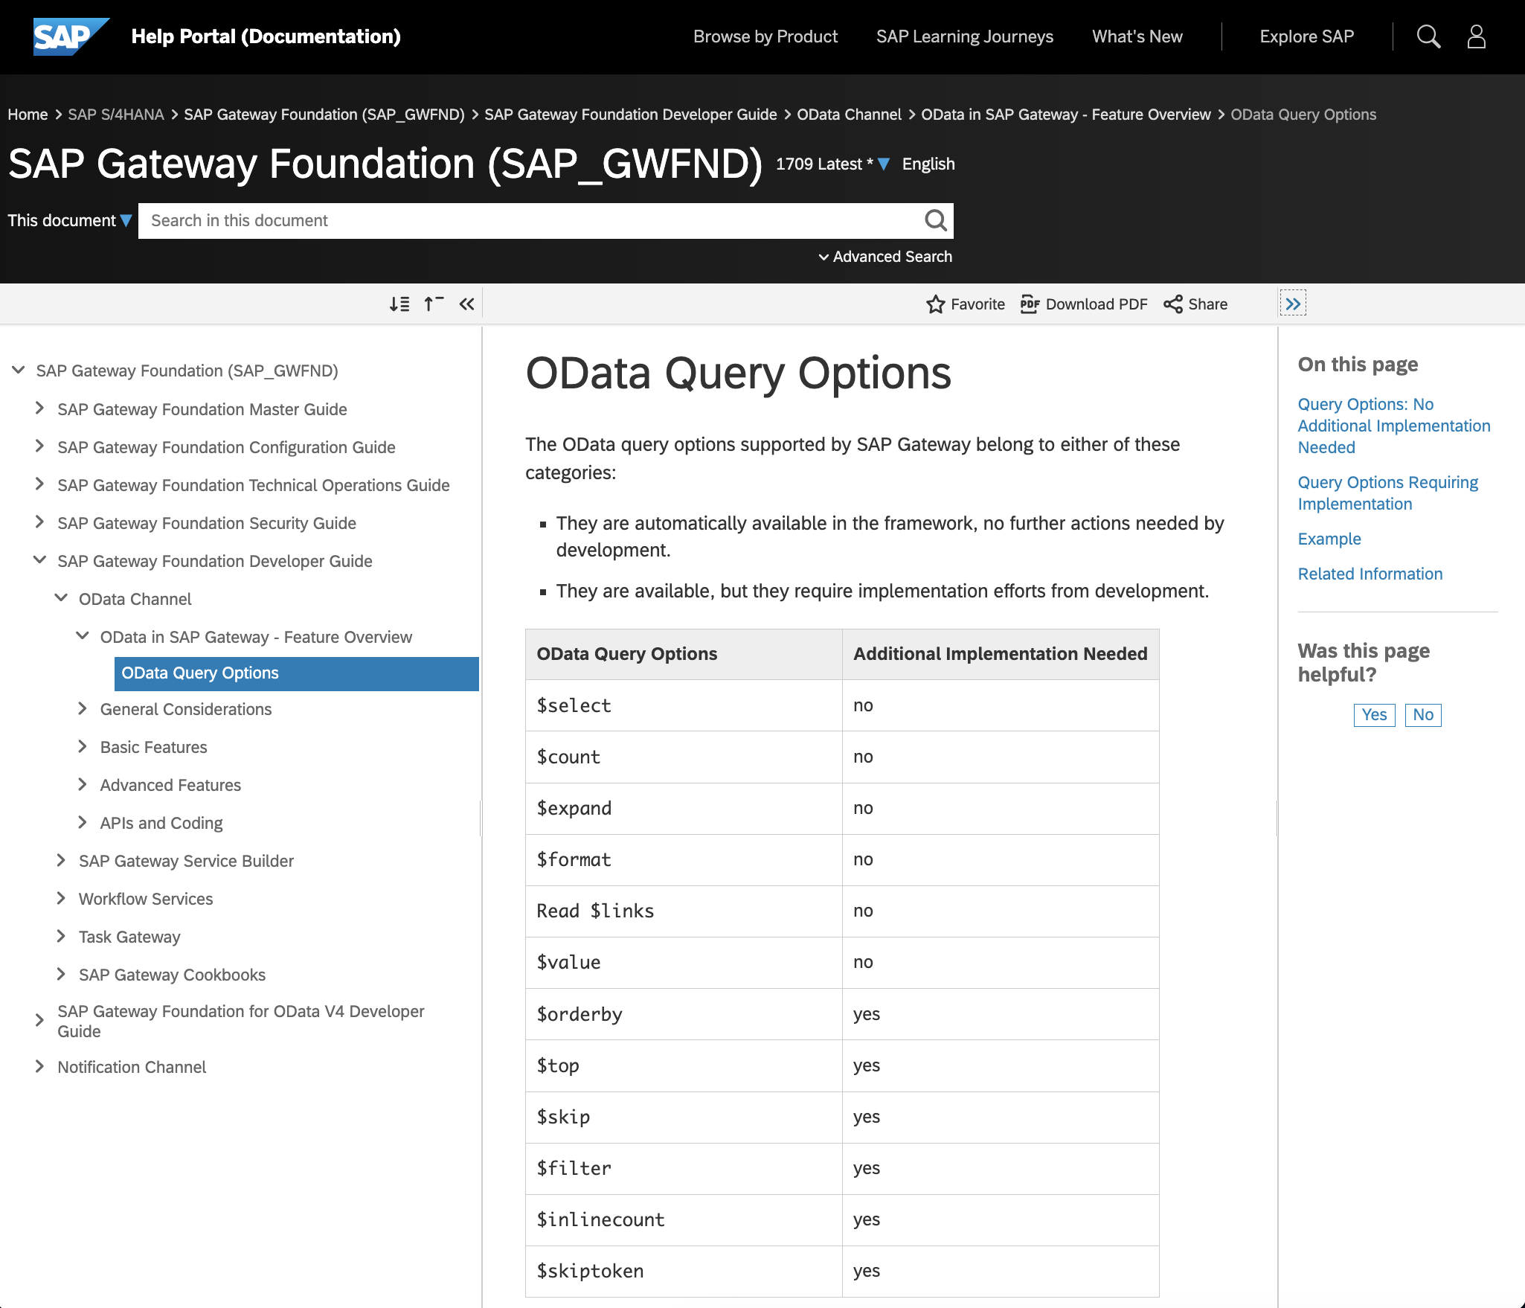
oData Query Options

Slide 61
oData Query Options

Slide 62
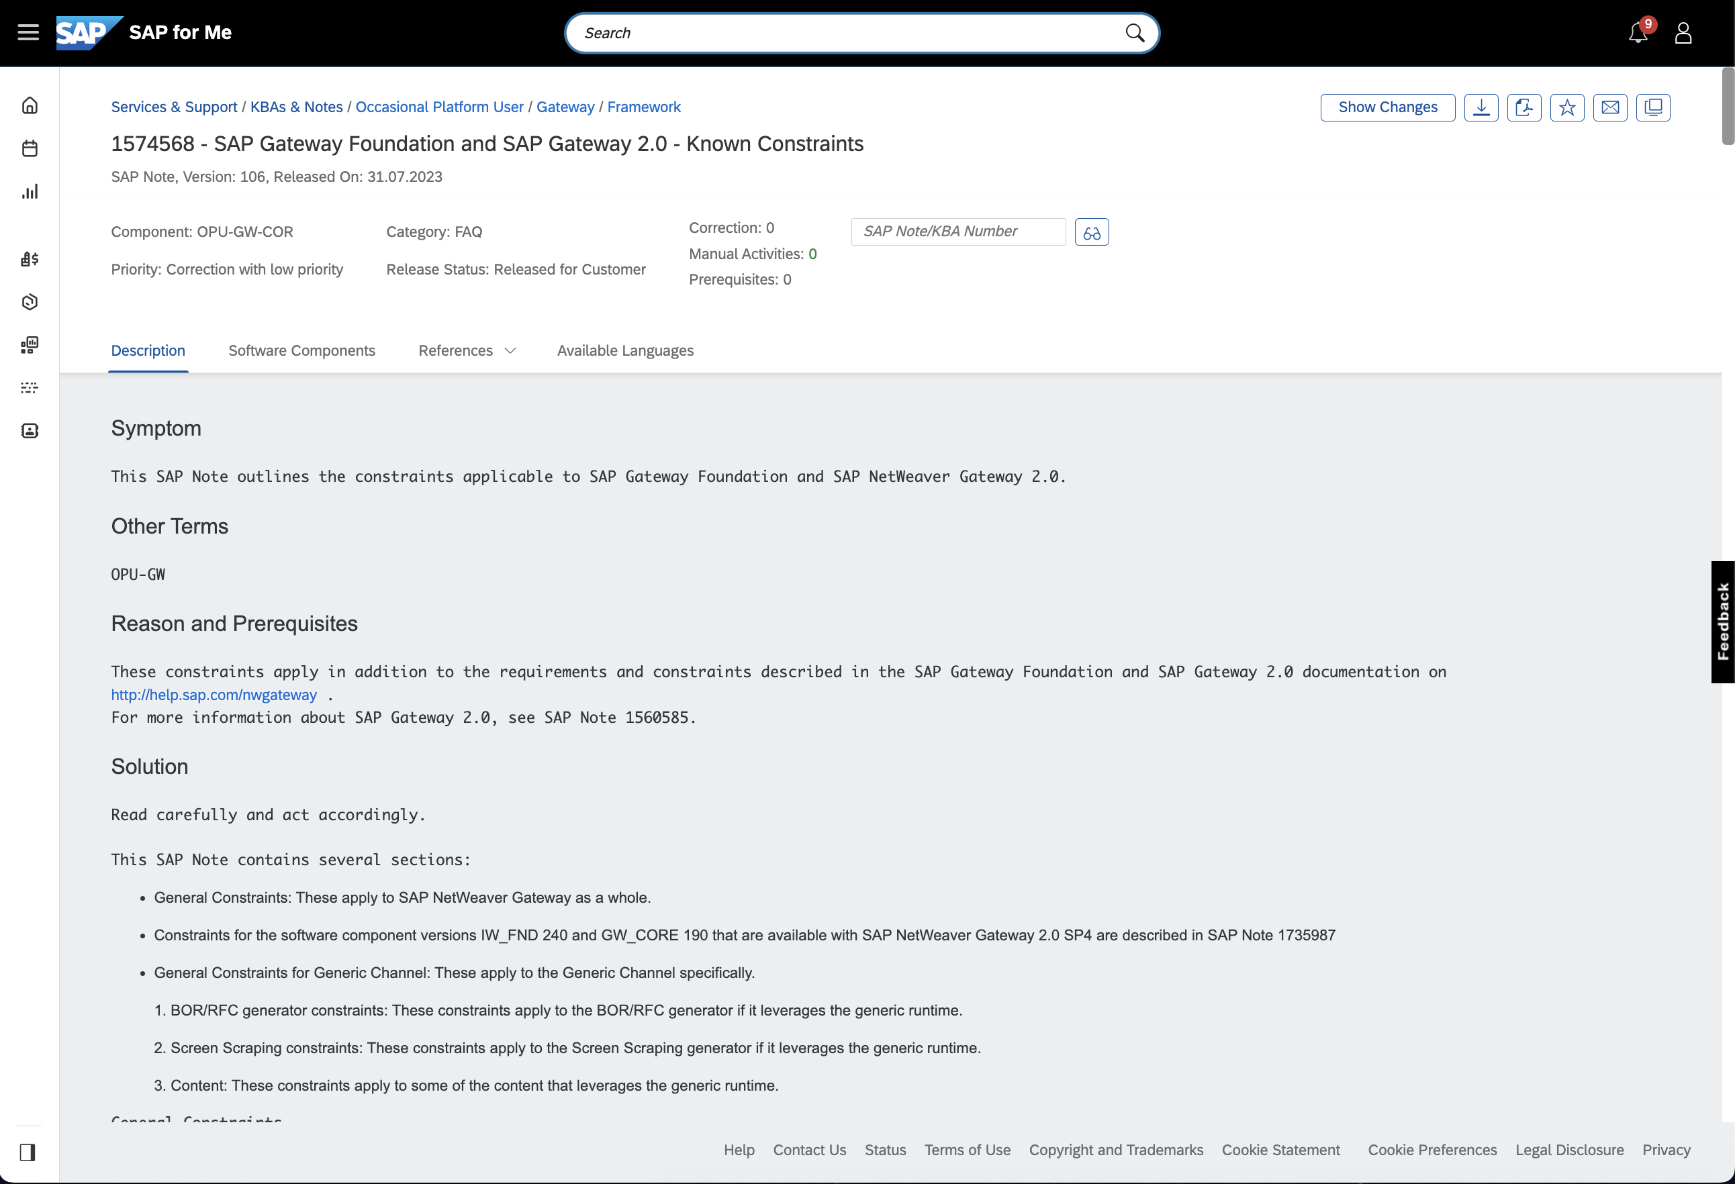
Known Constraints
SAP Note 1574568

Slide 63
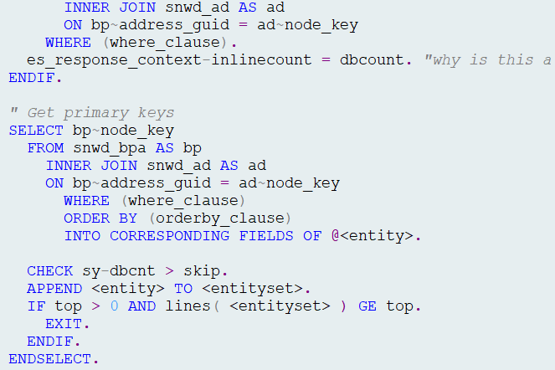
zif_gw_methods~get_entityset
Goal is to identify primary key(s) as quickly as possible and use them to fill entities.

Slide 64
zif_gw_methods~get_entityset
Create anonymous data object
$orderby
$filter
$inlinecount
$top & $skip
$count
$skiptoken
Fill entities

Slide 65
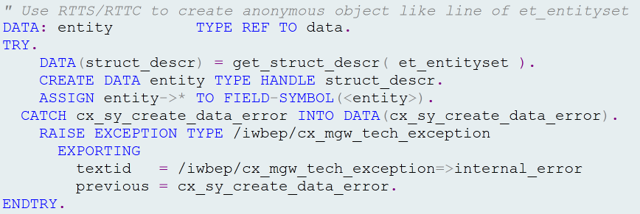
Create Anonymous data Object

Slide 66
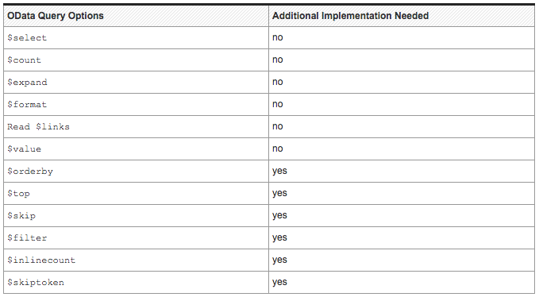
$orderby

Slide 67
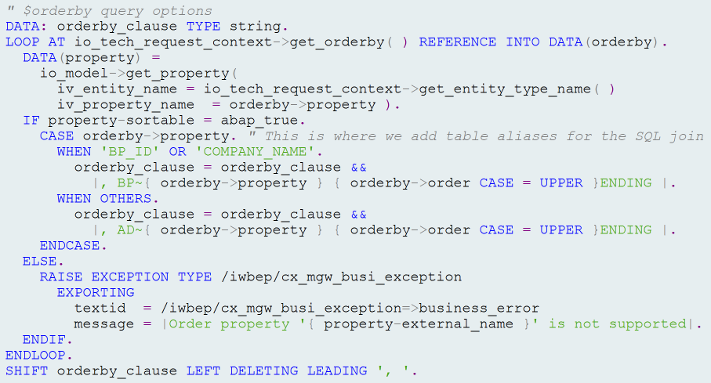
$orderby

Slide 68
$filter

Slide 69
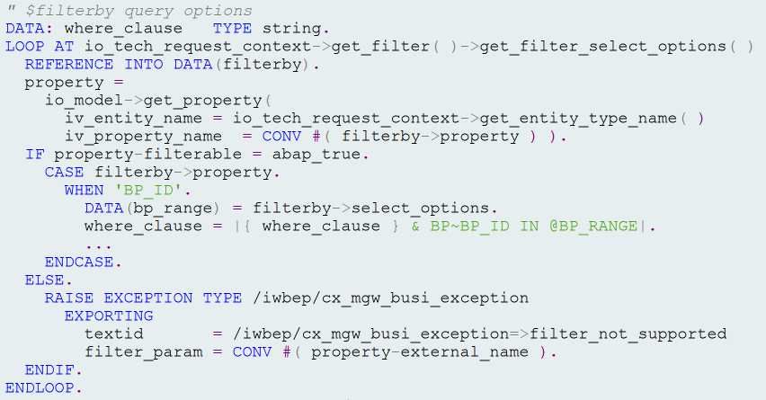
$filter

Slide 70
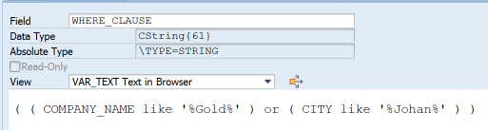
Complex $filter Queries
$filter=substringof(‘Gold’,Name) or substringof(‘Johan’,City)
*Note where_clause may require modification e.g. Table aliases, etc.

Slide 71
$Inlinecount

Slide 72

$inlinecount

Slide 73
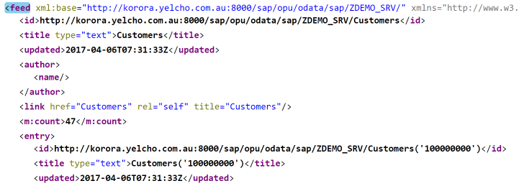
$inlinecount

Slide 74
$top & $skip

Slide 75
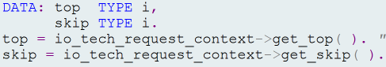

$top & $skip

Slide 76
$count

Slide 77
$count

Slide 78
$skiptoken

Slide 79
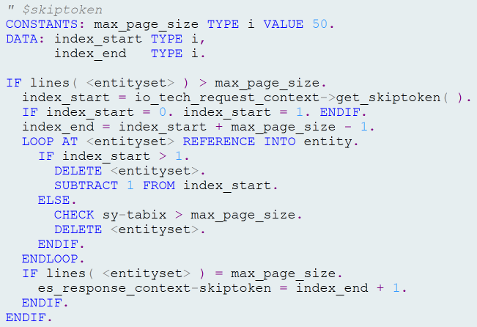
$skiptoken

Slide 80
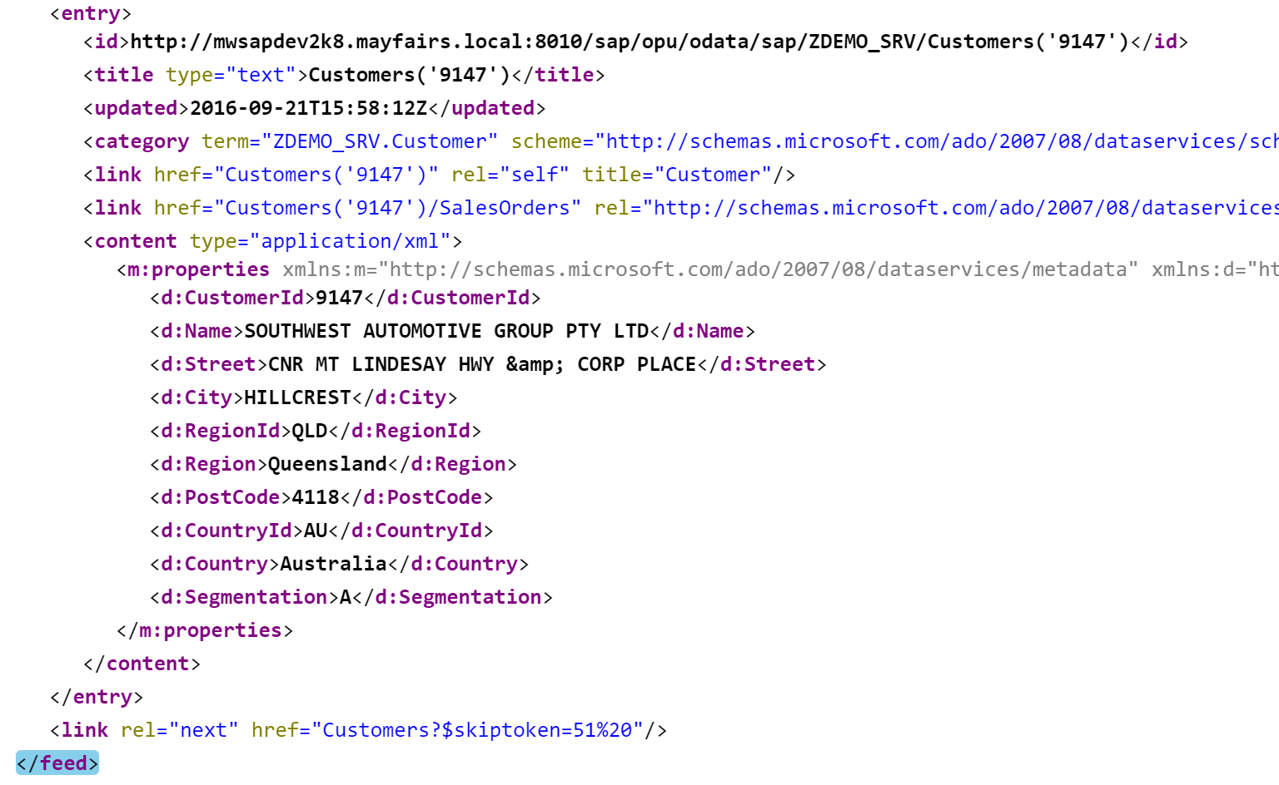
$skiptoken

Slide 81
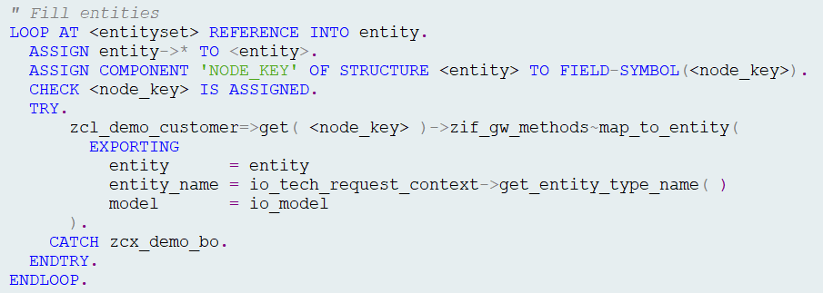
Fill Entities

Slide 82
Summary
Service Design
Design for consumers
Code patterns for reusability
The first & second rule

Slide 83
Where is the code?
https://github.com/grahamrobbo/building_gateway_services

Slide 84
Thank You
+61 412 402 441
graham@yelcho.com.au
@grahamrobbo

